Slide 1

Quality and results of meta-analyses on crop diversification
DiverImpact task 1.3
Damien Beillouin, Tamara Ben-Ari, David Makowski

Slide 2




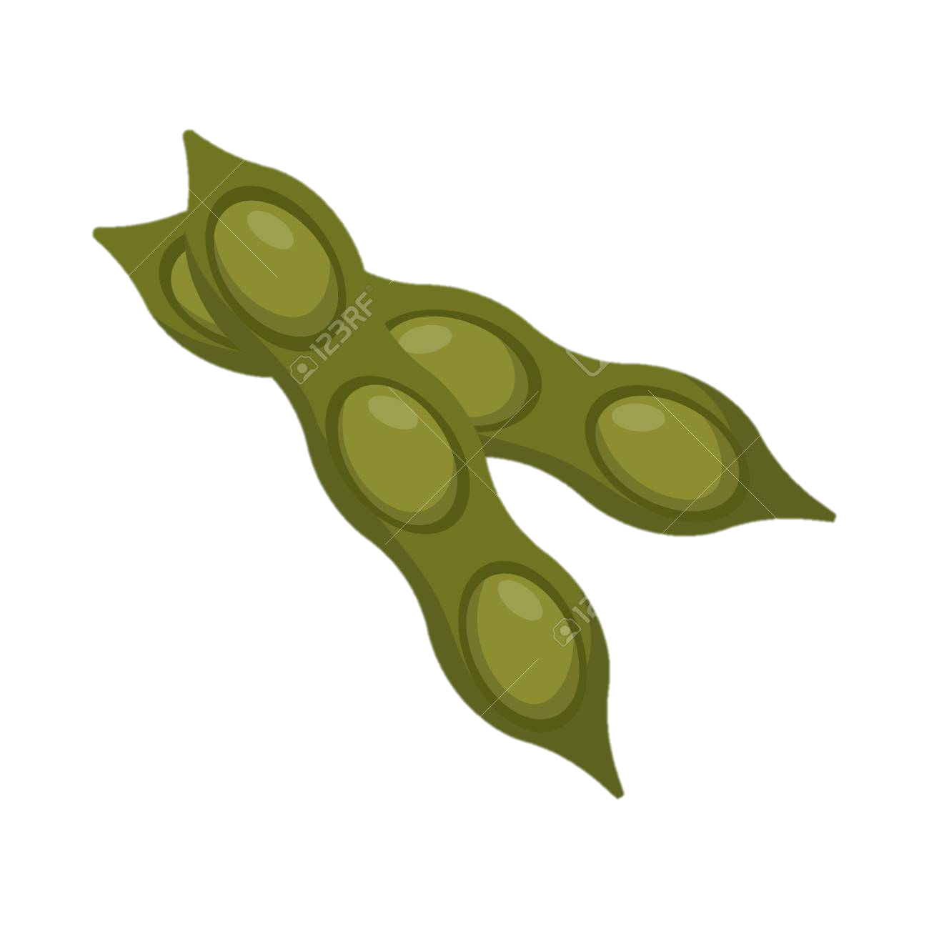

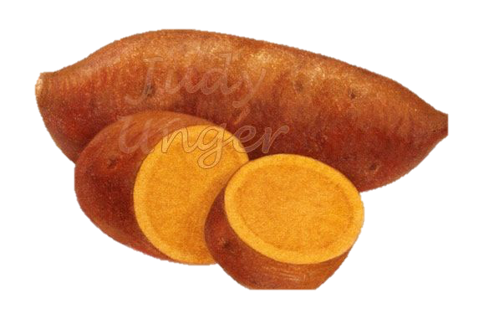
Crop diversification around the world
83 COUNTRIES (with > 5 individual experiments)
6231 EXPERIMENTS
# exp.
138 META-ANALYSES
USA …………. 1491
China…………536
Canada………324
Nigeria……….315
India…………..274
Germany……… 226
Kenya……………198
# of exp./ Meta-analyses
299 SPECIES
(studied in > 5 exp.)
7 DIVERSIFICATION STRATEGIES
Zea mays ………………1936
Triticum aestivum….1307
Glycine max…………...758
Hordeum vulgare…...484
Vigna unguiculata………..274
Secale cereale……….…… 361
Pisum sativum ……………347
% of world cult. areas
In the literature
Beillouin D., Ben-Ari T., Makowski D.

Slide 3
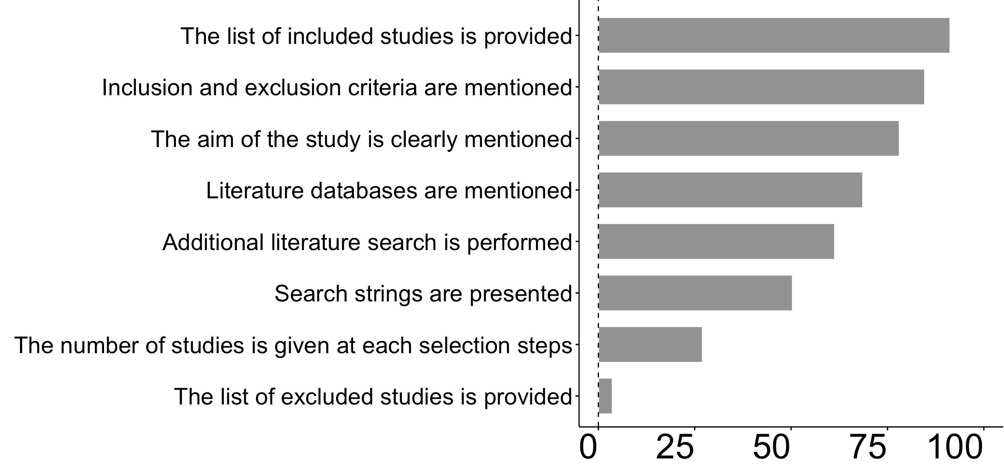
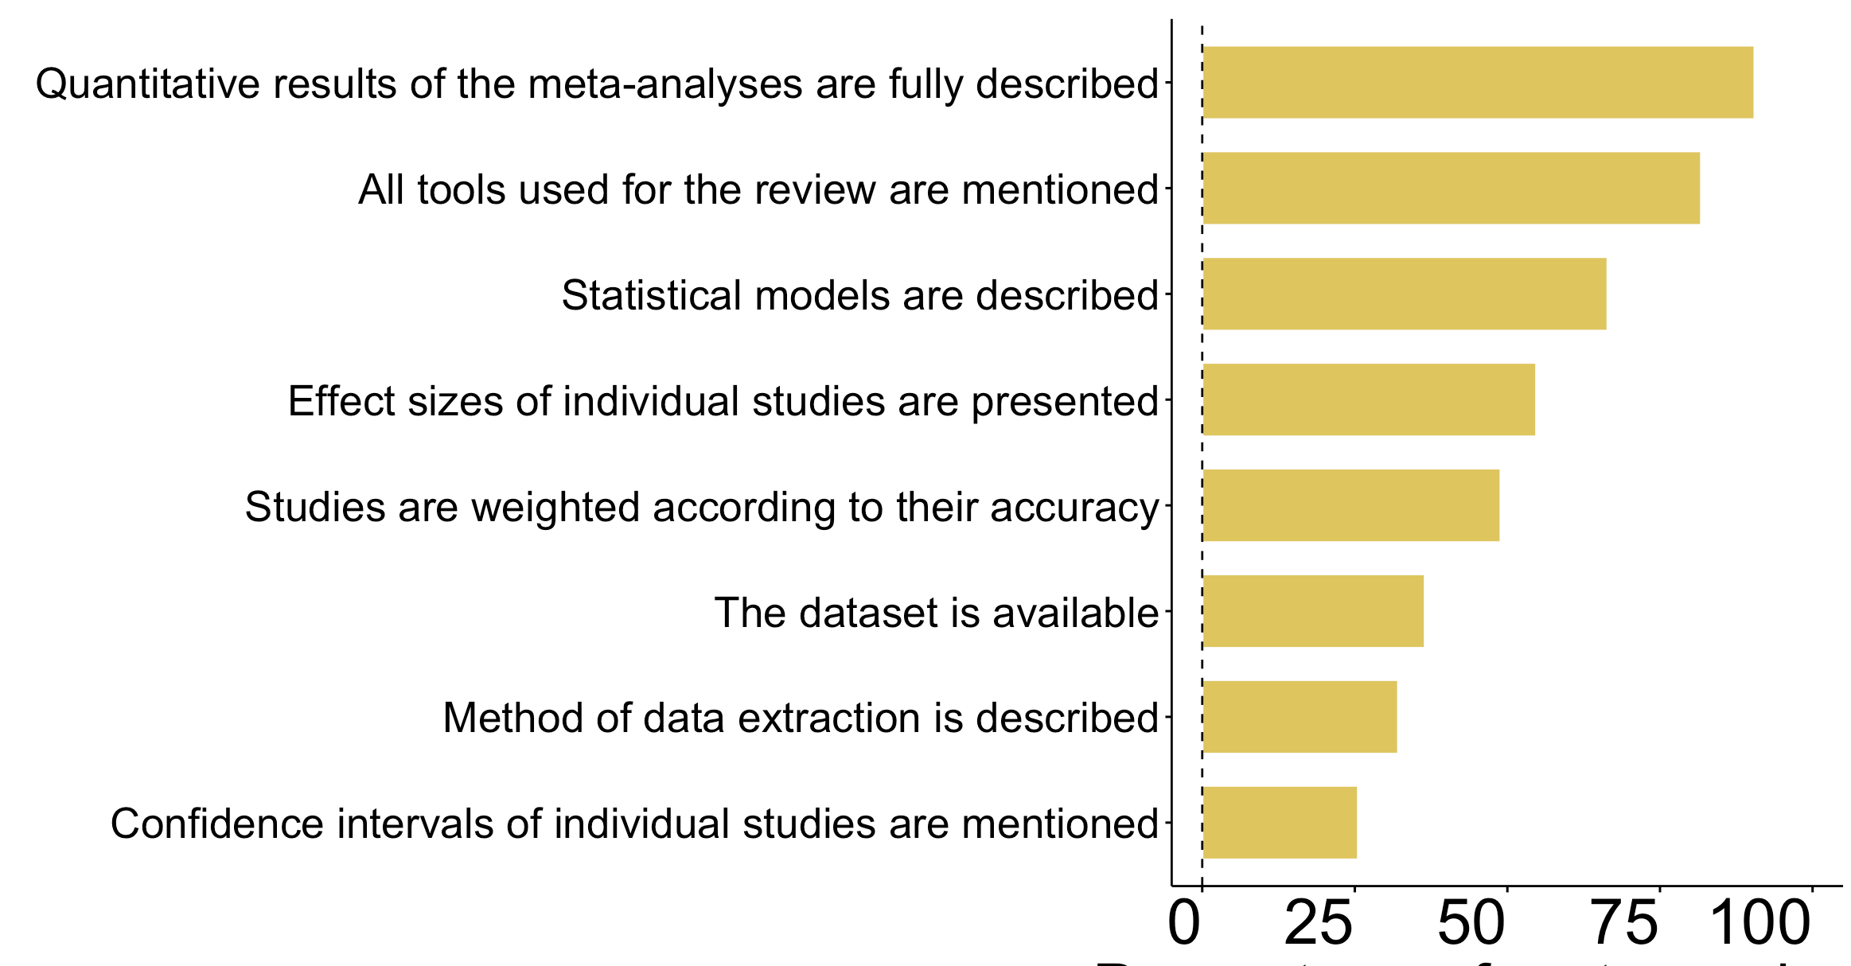
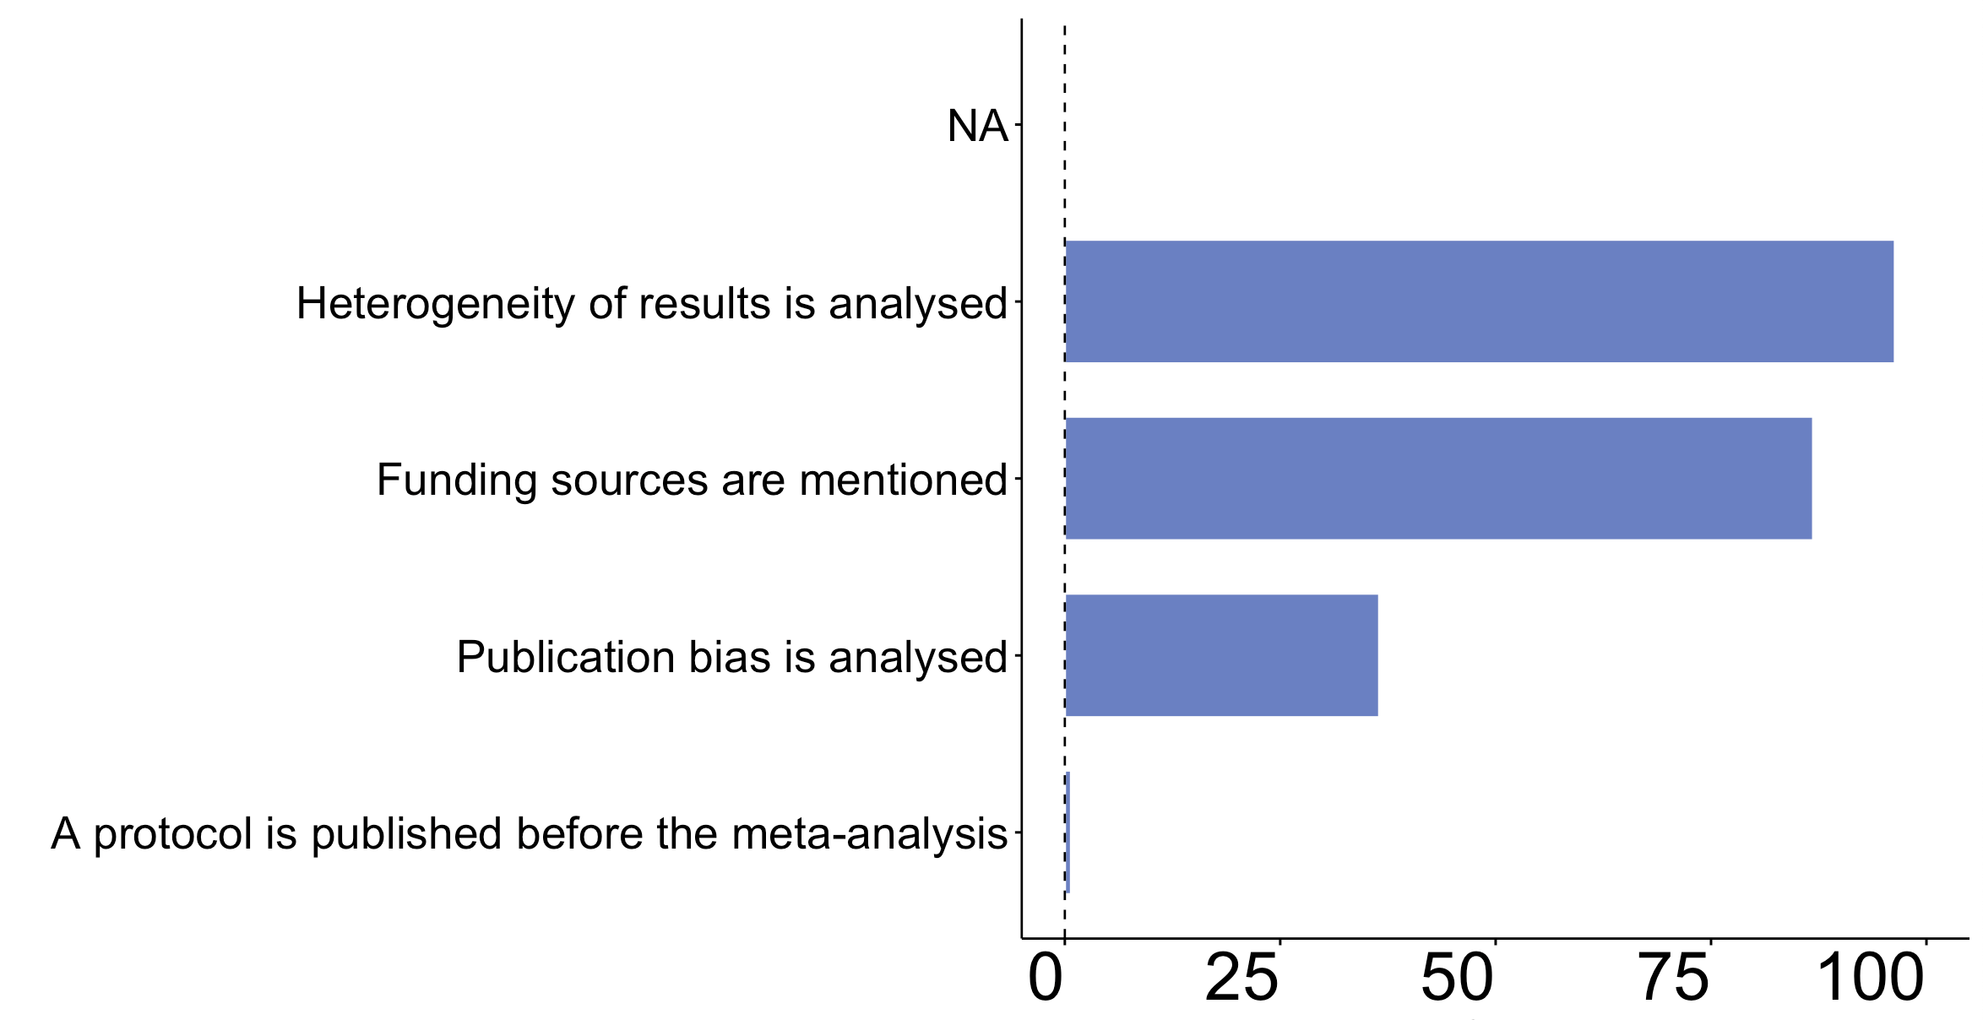
Crop diversification : QUALITY OF THE META-ANALYSES
REVIEW CRITERIONS
STATISTICAL CRITERIONS
# of Effect_sizes
% of Meta-analyses
% of Meta-analyses
BIAS CRITERIONS
EVOLUTION OF QUALITY CRITERIONS
% of Meta-analyses

Slide 4
Crop diversification : EVIDENCE GAPS
SOME strategies with LARGE GAPS
DETAILS FOR SOIL QUALITY CATEGORY
# of Effect_sizes
DETAILS FOR PESTS AND DIS. CATEGORY
Rm: 1 Effect_sizes can synthethized hundreds of experiments

Slide 5
Crop diversification : REDUNDANCY
EVER HIGHER REDUNDANCY
SOME META-ANALYSES with > 50% common experiments
Each point= a comparison
of 2 meta-analyses
% of common experiments
Publication year

Slide 6
Crop diversification : BENEFITS AND RISKS
OF CROP
DIVERSIFICATION
NUMEROUS BENEFITS
HIGHER
FOR MORE DIVERSIFIED SYSTEMS
LOWER
Profitability
Production
Input use eff.
Soil quality
Biodiv. Assoc.
GHG emision
Water quality
Productrs quality
Water efficiency
Pests regulation

Slide 7
Crop diversification : BENEFITS AND RISKS
OF CROP
DIVERSIFICATION
OF CROP
DIVERSIFICATION
OF CROP
DIVERSIFICATION
OF CROP
DIVERSIFICATION
Biodiv. Assoc.
GHG
Input use eff.
PESTS
OF CROP
DIVERSIFICATION
OF CROP
DIVERSIFICATION
OF CROP
DIVERSIFICATION
OF CROP
DIVERSIFICATION
PRODUCTION
PRODUCTS quality
SOIL quality
WATER use

Slide 8
Quality and results of meta-analyses on crop diversification
DiverImpact task 1.3
Damien Beillouin, Tamara Ben-Ari, David Makowski

Slide 9
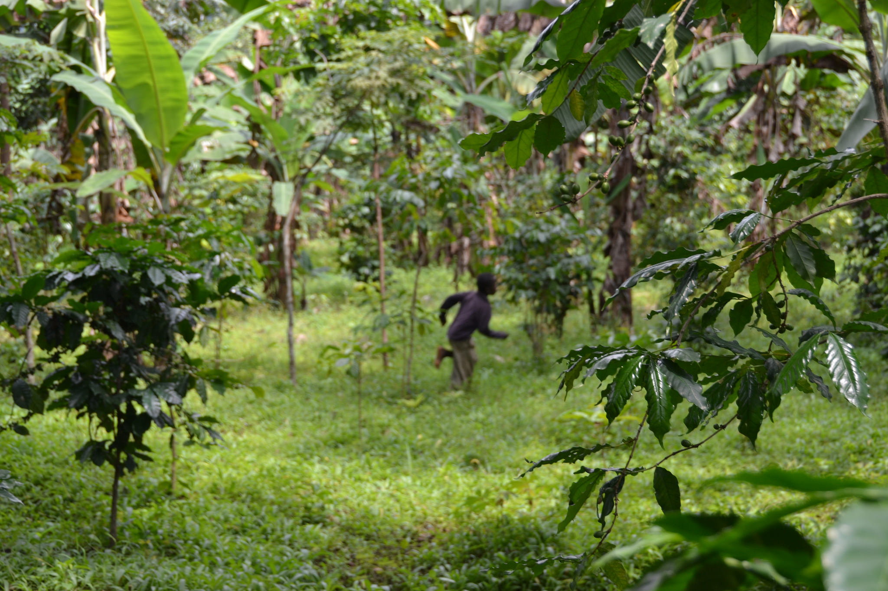
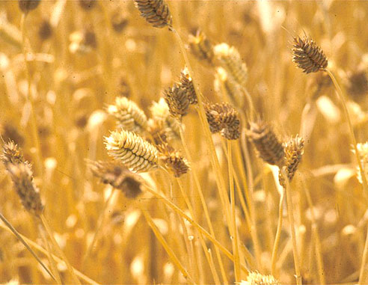
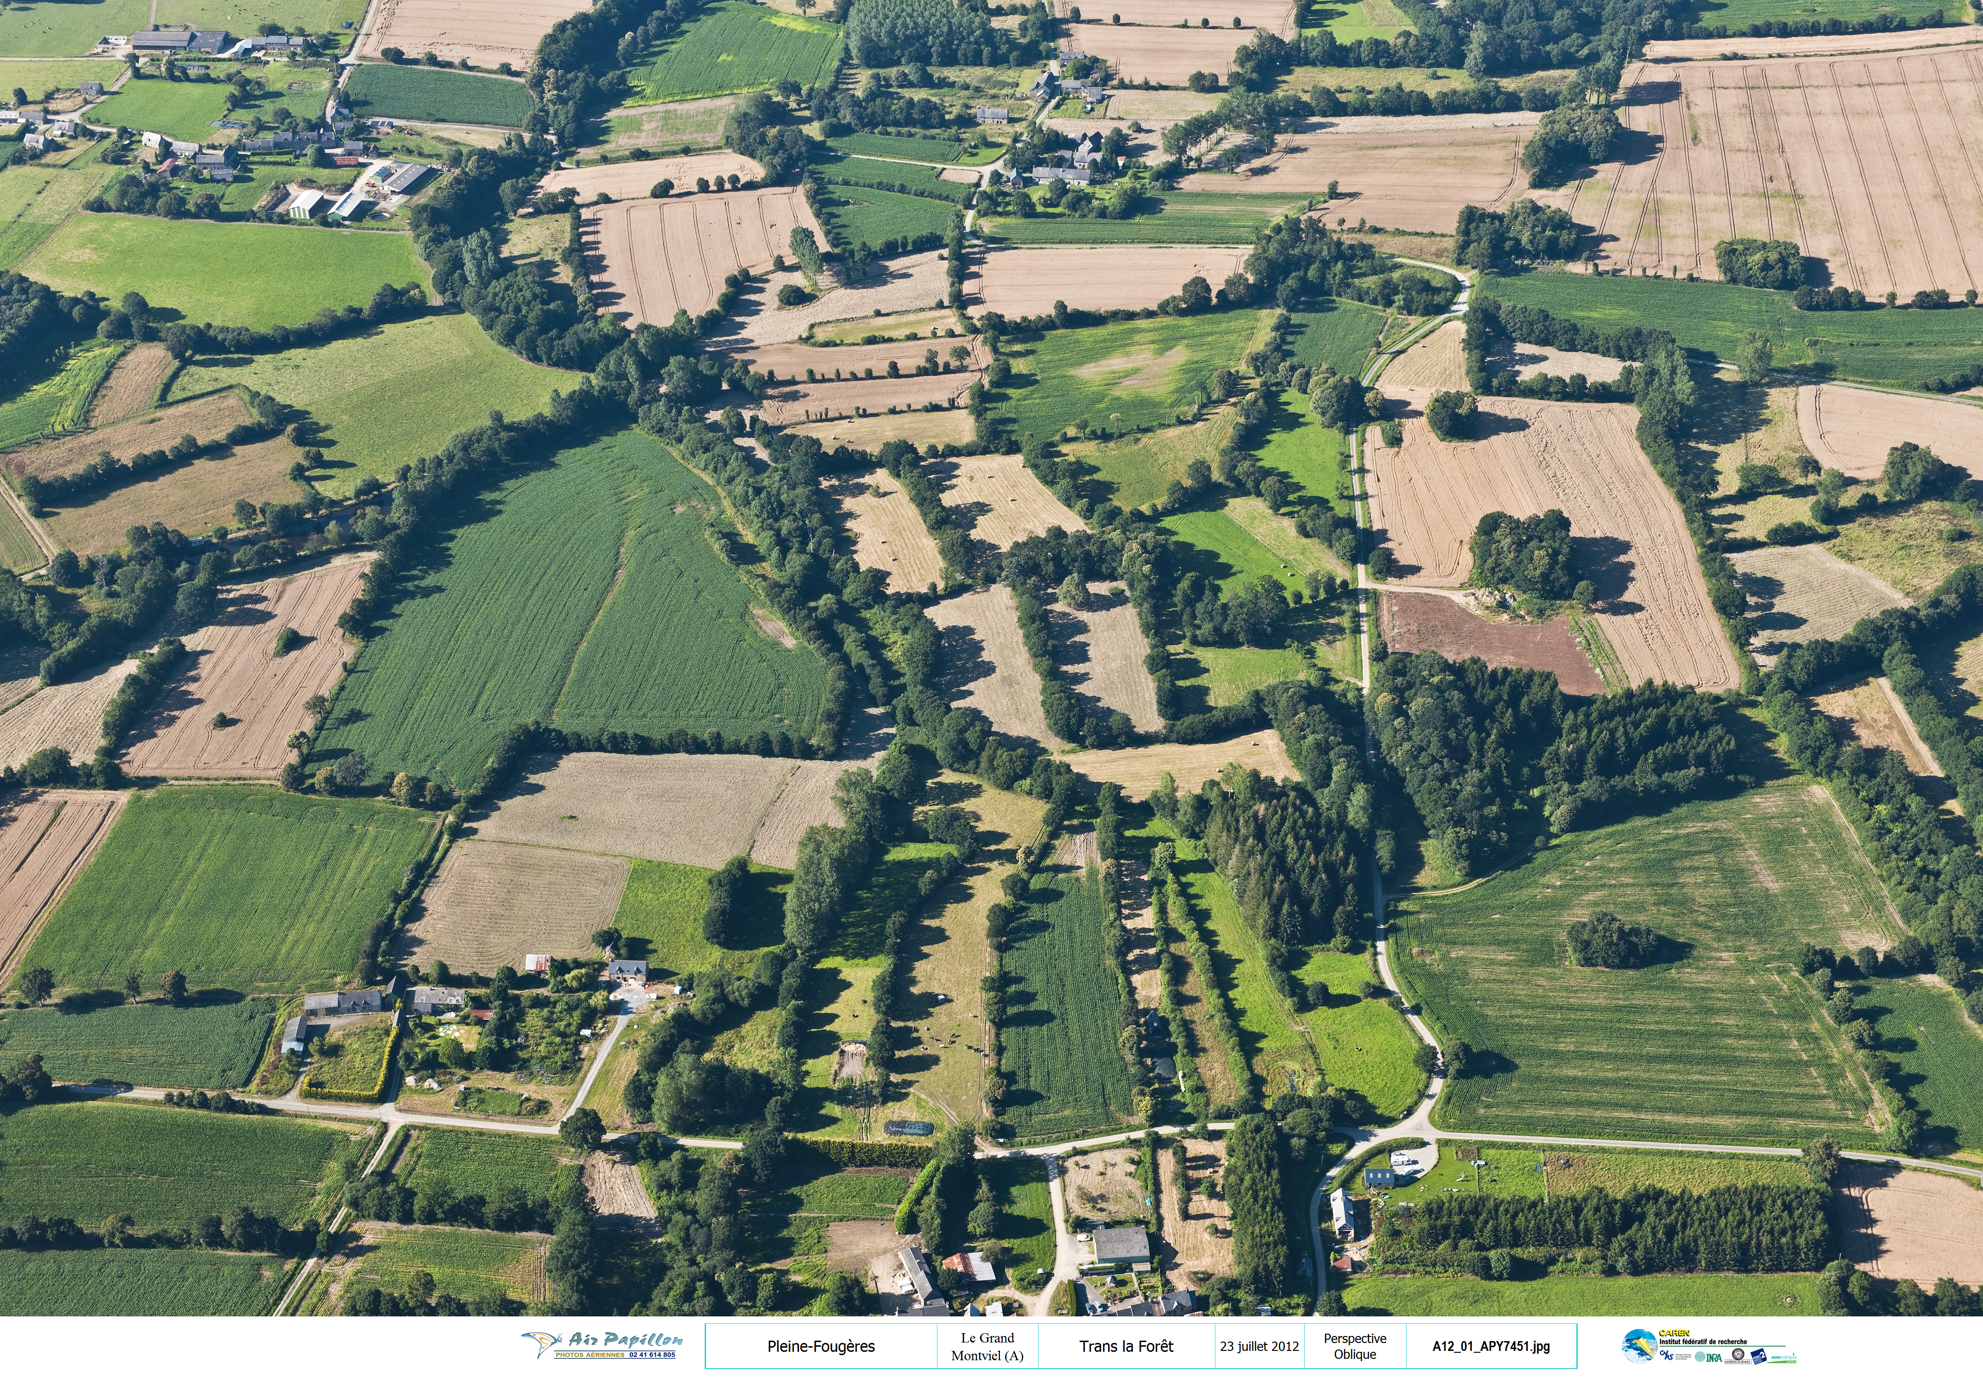
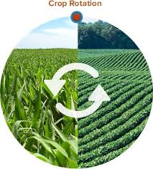
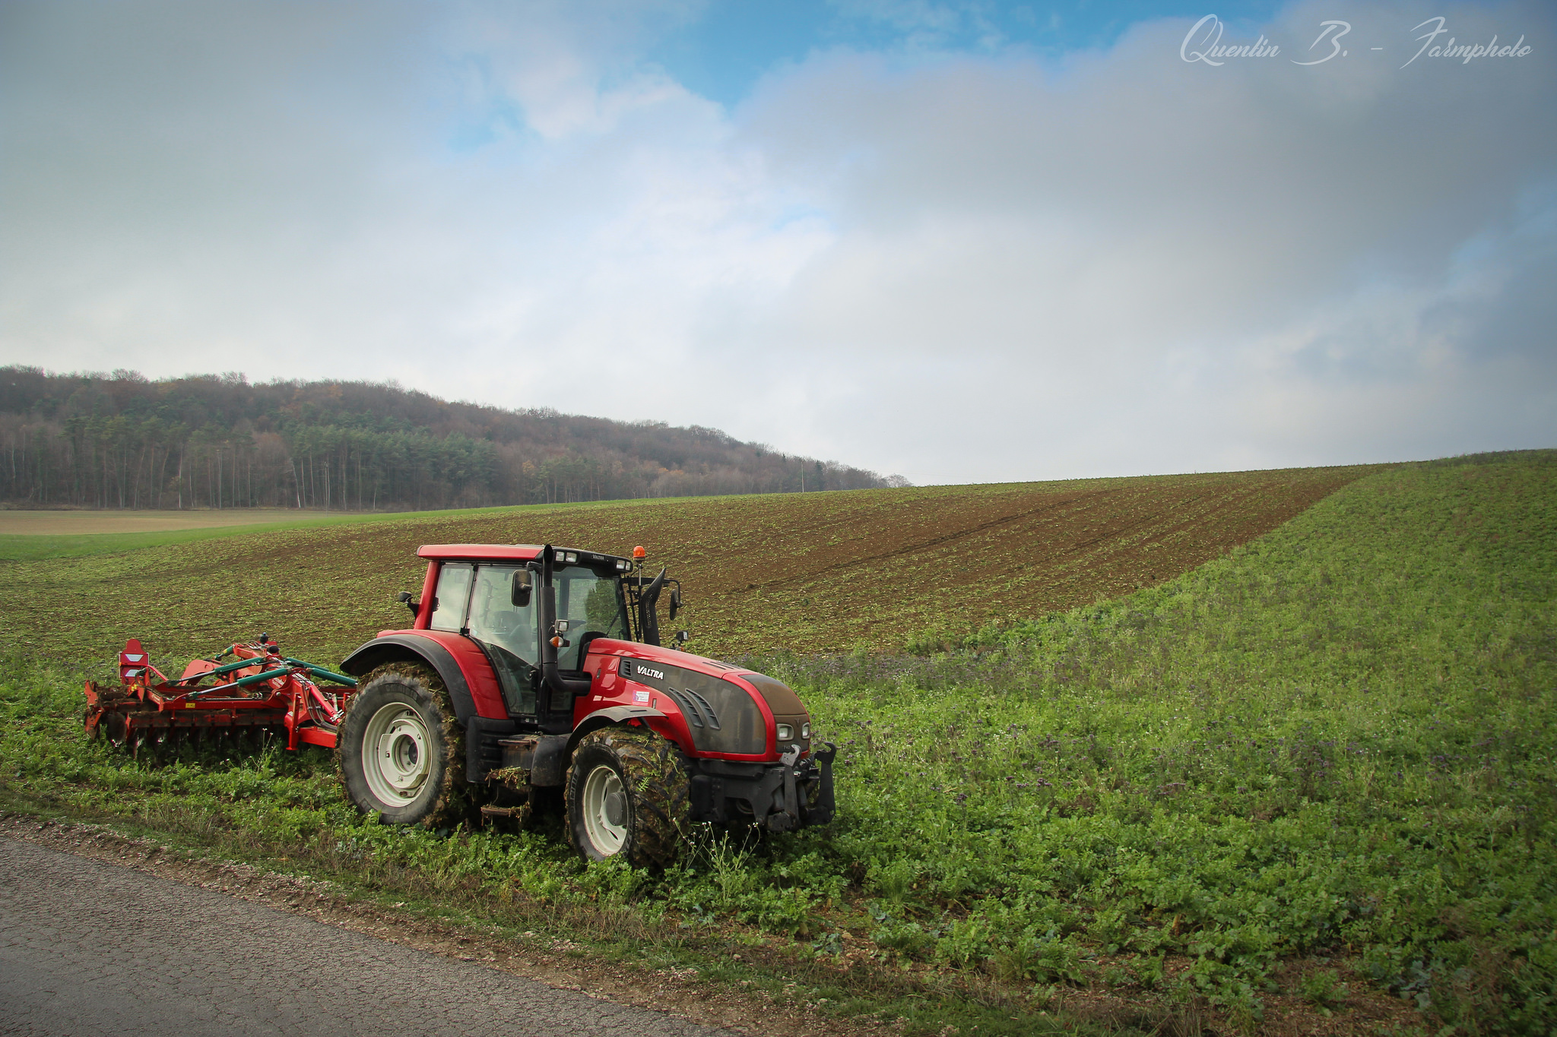
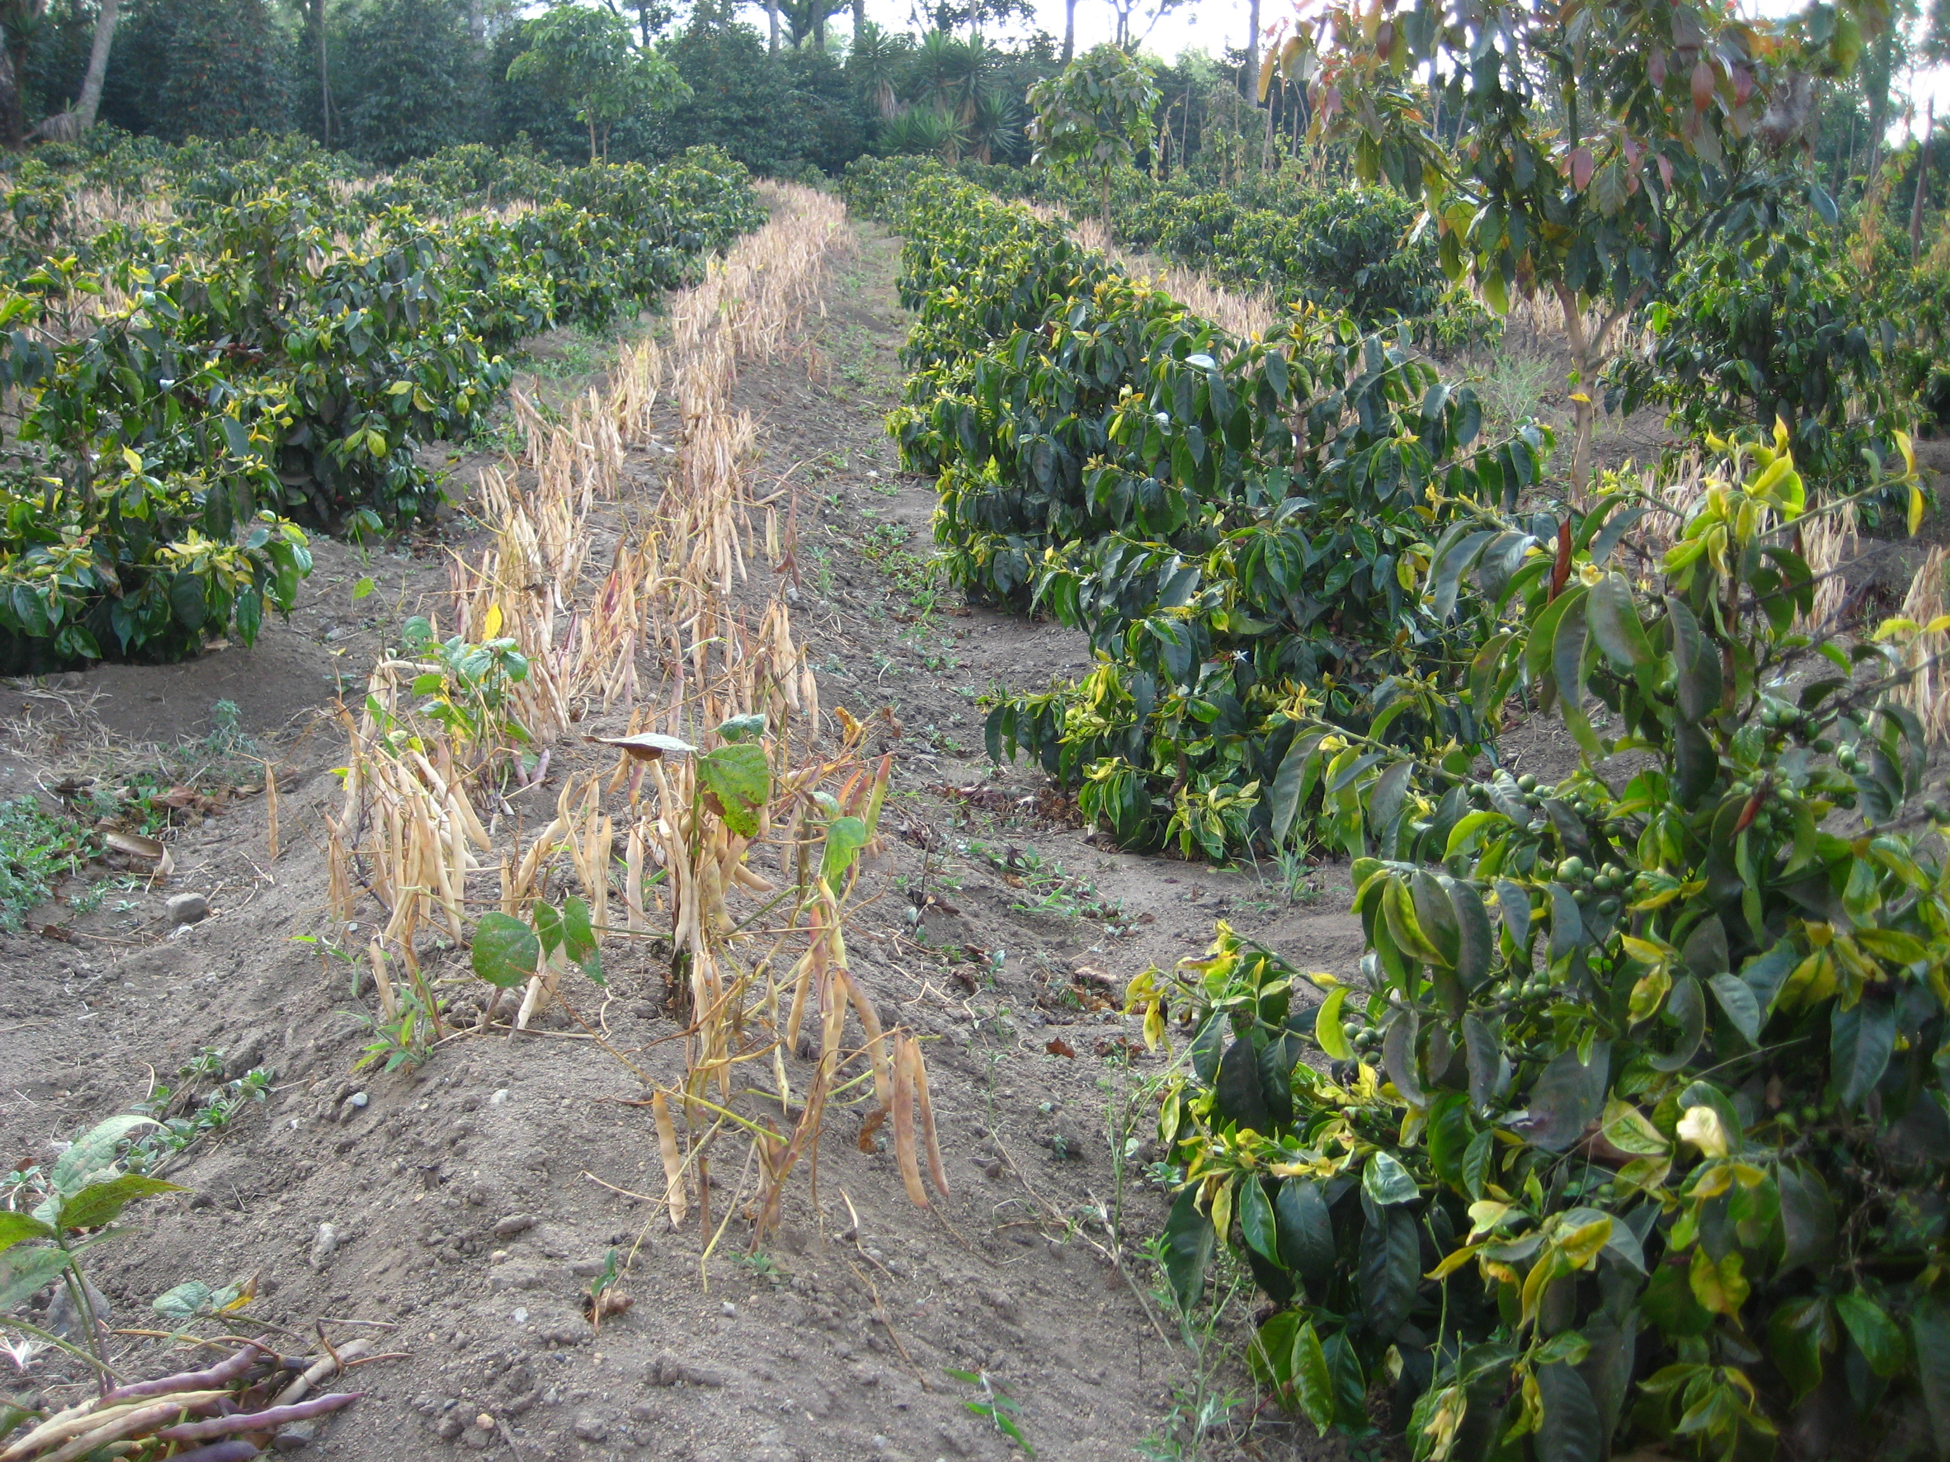
Numerous strategies of crop diversification are proposed
Include a wide range of practices aiming at incorporating agrobiodiversity across multiple spatial and/or temporal scales (Redliech et al., 2018)
Agroforestry
Cultivar mixture
Landscape heterogeneity
Associated
plant species
Intercropping
Rotation

Slide 10
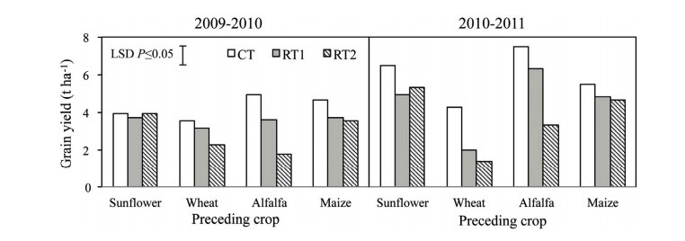
Many experiments have been published
Over 35,000 experimental results have been published on this topic between January 1990 and November 2018 in agronomy peer-reviewed journals
Example of individual experiments
-Strategie: Rotation
-Region: Italy
-Output: Yield
Ercoli et al., 2016

Slide 11
Various outcomes are analysed
Production: yield, biomass,…
Environment: soil quality, water quality, biodiversity,….
Economic: profitability, income, ….

Slide 12
A large quantity of data is available
How to synthethize knowledge?
1. Narrative reviews

Slide 13
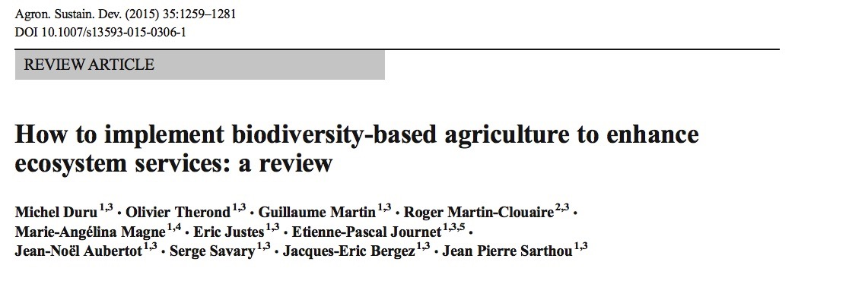
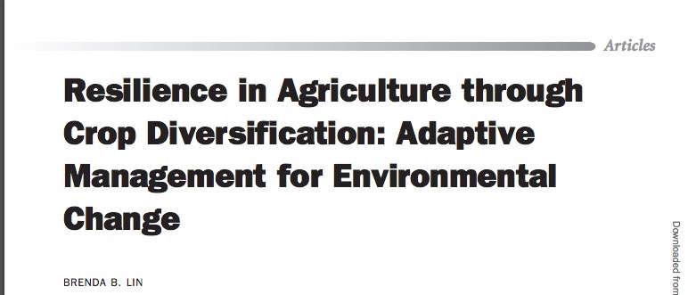
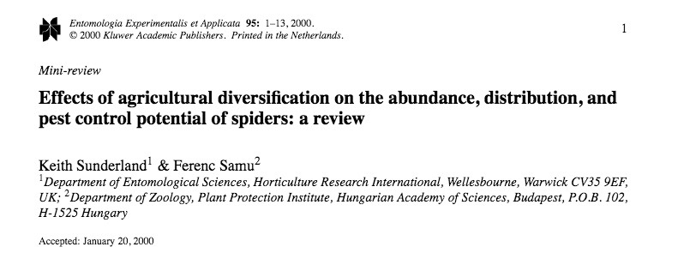
A large quantity of data is available
Example of narrative reviews

Slide 14
A large quantity of data is available
How to synthethize knowledge?
2. Systematic and quantitative reviews (i.e. meta-analyses)

Slide 15
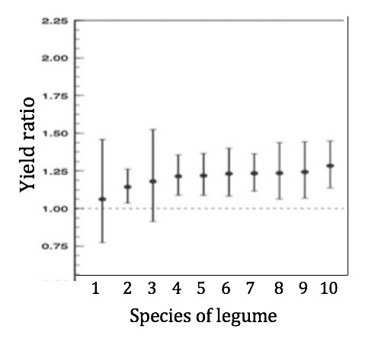
A large quantity of data is available
Example of meta-analysis: Cernay et al., 2017
Yield ratio =
Yield of cereals cultivated after legumes
Yield of cereals cultivated after cereals
Mean of all individual studies
(for legume #X)
95% Confidence intervals

Slide 16
Meta-synthesis (i.e. a meta-analysis of meta-analyses)
Give an overview of impacts of all crop diversification strategies
Advantages
- More efficient as synthesizing all individual studies
- Quantification (same results as synthesizing all individual studies)
- Cover all diversification strategies

Slide 17
Meta-synthesis (i.e. a meta-analysis of meta-analyses)
Give an overview of impacts of all crop diversification strategies
Drawbacks
- Handling the redundancy of individual studies across meta-analyses
- Reliability of results depends on quality of published meta-analyses
- Different metrics are used in the meta-analyses (ratio, mean difference, …)

Slide 18
A systematic review of the literature
Search string:
Database:
Search in the reference lists of selected meta-analyses
(meta-analysis OR meta analysis) AND (cropping system OR crop* OR agriculture) AND ((rotation OR Diversification OR intercrop* OR cover crop OR mixture) OR (organic AND (system OR agriculture)) OR (conservation AND (system OR agriculture)) OR no till* OR agroforestry OR agroecology).
Web of Science, CAB abstract, Greenfile, Environment Complete Database, Agricola, and Google Scholar

Slide 19
A systematic review of the literature
Retrieved Meta-analysis: 138
Number of primary studies synthethized: 6231
Number of scenarios quantified : 3813

Slide 20
General characteristics of the studies

Slide 21
Years of publication

Slide 22
Type of diversification
100
75
50
% of total studies
0
1950
1975
2000
Year of publication
Beillouin et al., 2019 Soumis (Data in brief)

Slide 23
Geographical distribution of individual studies
Number of experiments
1
7
55
400
1

Slide 24
Geographical distribution of individual studies (option B)

Slide 25
W. & E. Europe (n=782)
E. Asia (n=194)
Type of diversification
(Pas réactualisé)
N. & W. Africa (n=276)
N. America (n=1286)
S. Asia (n=63)
Central & S. America (n=326)
Oceania (n=202)
E. & S Africa (n=286)
W. & central
asia (n=308)
Beillouin et al., 2019 Soumis (Data in brief)

Slide 26
Diversification studied by region
(Pas actualisé)
Rotation
Agroforestry
Associated plant
Intercropping
Landscape
Crop mixture

Slide 27
Quality score of the meta-analyses

Slide 28
Quality score By diversification

Slide 29
Number of meta-analyses by outcome and diversification
Soil Quality
Production
Water quality
Associated biodiversity
Pest and diseases regulations
Green house gaz emision
Water use
Profitability
Input use efficiency
Products quality
Yield stability
Yield and quality
Root biomass

Slide 30
Même chose mais avec les Effect-sizes
Soil Quality
Production
Associated biodiversity
Pest and diseases regulations
Green house gaz emision
Products quality
Water quality
Water use
Profitability
Yield stability
Root biomass
Input use efficiency
Yield and quality

Slide 31
Identification of knowledge gaps and Quantifying the impact of diversification

Slide 32
All log(Ratio) Pas actualisé
Positive
Rotation
Negative
Outcomes
Biodiversity
Positive
Soil Quality
Agroforestry
Impact of crop diversification
Productivity
Negative
Associated
plant species
Positive
Negative

Slide 33
Comparison of diversification strategies
Ratio of performance (diversified system/ less diversified)

Slide 34
Qualité et résultat des méta-analyses sur la diversification des cultures
DiverImpact task 1.3
Damien Beillouin, Tamara Ben-Ari, David Makowski

Slide 35
Type de diversification
Agroforestery: i) au moins deux espèces végétales qui interagissent biologiquement, ii) au moins une des espèces végétales est une plante ligneuse, et iii) au moins une des espèces végétales est gérée pour la production de cultures fourragères, annuelles ou vivaces.
Associated plant species: Cette catégorie, principalement définie par la fonction des plantes, englobe les cultures de couverture, les cultures pièges, les cultures répulsives, les cultures tampons et les cultures complémentaires.
Cultivar mixture: La culture simultanée dans le même champ de plusieurs cultivars d'une même espèce.
Intercropping: Culture simultanée dans un même champ de deux ou plusieurs cultures (espèces différentes) pendant tout ou partie de leur cycle de croissance. Toutes les espèces cultivées sont récoltées.
Landscape heterogeneity: Composition du paysage (diversité de l'habitat pérenne, couverture semi-naturelle de l'habitat) et configuration (taille moyenne des parcelles).
Rotation: Succession récurrente d'un ensemble de cultures sélectionnées cultivées sur une terre agricole particulière chaque saison ou chaque année selon un plan défini.

